Slide 1
Research Name: Intel XeonProccesor
Name:
Nishu Akter
ID:UG02-48-18-017
Kaspia Tabbasom
ID:UG02-47-18-046
State University Of Bangladesh
Department Of Computer Science and Engineering

Slide 2
Outline
1.Abstract
2.Introduction
3.Proposed methodogy
4.The Number of Cores
5.Better Endurance for Higher Server Activity
6.Is the Xeon Best For Your Business? 7.Should Gamers Upgrade to the Xeon?
8.Advantages and disadvantages
9.Why this paper is unique?
10.Terminology usedin this paper
11.The Importance of Maximizing Performance on Intel Xeon processors first
12.So What Exactly is the Intel Xeon Processor? 13.Conclusion
14.future work
15.Acknowledgments
16.Greetings

Slide 3
Abstract
In this research, we present an performance evaluation of a intel xeon processor. This is the new version of sandy bridge processor for server and workstation market. It employs an integrated memory controller, dual intel quick path interconnect (QPI) port and integrated pcie 3.0 controller. We assessed these architectural enhancements using the high performance computing challenge (HPCC) benchmarks and NAS parallel benchmarks (NPB). For interconnect analysis we have used the netpipe performance evaluator. We compare and contrast the results of cluster based on intel xeon processor.

Slide 4
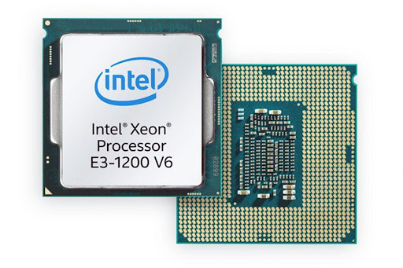
Introduction
An intel xeon processor is one of intel's state-of-the-art central processing units (CPU). The intel xeon processors are definitely power processors. They have a large number of cores, and they also have special features that make them great for running intensive programs and mission-critical tasks. Many supercomputer applications are unable to achieve good sustained performance due to memory bandwidth issue. The sandy bridge development team responded with a new architecture implemented in the intel xeon family. This new processor has been used to build a cluster with fourteen data rate (FDR) inﬁniband (IB) 14gb/s data rate per lane. The architecture is a revolutionary product from several perspectives.

Slide 5
Proposed methodogy
The intel xeon processors are definitely power processors. They have a large number of cores, and they also have special features that make them great for running intensive programs and mission-critical tasks. Arguably the most important of these features is error-correcting code memory.
The xeon used is the microprocessor as known as knights corner. The microprocessor has 57 physical in-order cores, and each one has 32 512-wide vector registers and supports four hardware threads. The device has a total of 6 GB GDDR main memory, and each core has 64 KB cache and 512 KB of cache. The intel xeon is built in a 22nm technology with intel’s 3-D trigate transistors. The operating system is the centos 7.0 with intel MPSS version 3.7 and GDB 7.8 with intel extensions. The tested device is protected with machine check architecture (MCA) reliability solution, which includes ECC in memory structures .

Slide 6
The Number of Cores
We know now that the intel xeon platinum processor has better PCP, but another thing that similarly impacts the performance of a processor is the number of cores that it contains. More cores are beneficial in that they can improve speed and responsiveness when you are running multiple CPU intensive programs simultaneously (they can help your CPU temperature stay low). The intel xeon has over 24 cores, whereas the intel core i7 has about 18 cores

Slide 7
Better Endurance for Higher Server Activity
Since the intel xeon is built especially for a server environment, it can handle a much higher volume of server activity; running for 24 hours a day. This means higher endurance and greater longevity than almost every other processor, including the i7, and it is also what makes the xeon line an excellent choice for businesses that have a lot of server activity.

Slide 8
Is the Xeon Best For Your Business?
So, should your business upgrade to the xeon processor? It all depends on how extensive your business is and what your needs are. If your business has servers large enough to benefit from the additional cores, then yes, go ahead and upgrade. Intel recommends taking full advantage of their xeon processors by pairing them with their solid-state drives.
The ecc ram option is also great for ensuring maximum uptime, and the sheer longevity of the xeon processors makes them a worthy investment as well. For first-class hosting, your business cannot do better than the xeon processors.

Slide 9
Should Gamers Upgrade to the Xeon?
The intel xeon is designed for workstation computers, but that doesn’t mean only businesses can use it. PC users can use the xeon for its efficient handling of even the most intensive creative applications like 4K video editing, computer-aided design, and 3D rendering. But what about gaming? Should gamers consider getting the xeon processor?
Even though the xeon can be a great option for gaming computers (especially if you are looking to build a budget gaming computer), there are several caveats. For one, xeon processors cannot be overclocked, which is a popular technique used by gamers to boost performance. Intel core processors, like the i7, can be overclocked. That being said, given the extraordinary processing power and speed of the xeon processors, it is unlikely that you will even need to overclock if you get the right processor for your needs. However, enthusiast gamers should still go with the safer option and stick to a core or ryzen series processor.

Slide 10
Advantages
Intel xeon is practically built for workstation computers.
The large number of cores and advanced ram functions give it enough processing power and speed to handle the most intensive creative applications, from computer-aided design (cad) to 4k video editing to 3d rendering.

Slide 11
Disadvantages
Some shortcomings that make xeon processors unsuitable for most consumer-grade desktop pcs include lower clock rates at the same price point (since servers run more tasks in parallel than desktops, core counts are more important than clock rates). Usually there is an absence of an integrated graphics processing unit (GPU).

Slide 12
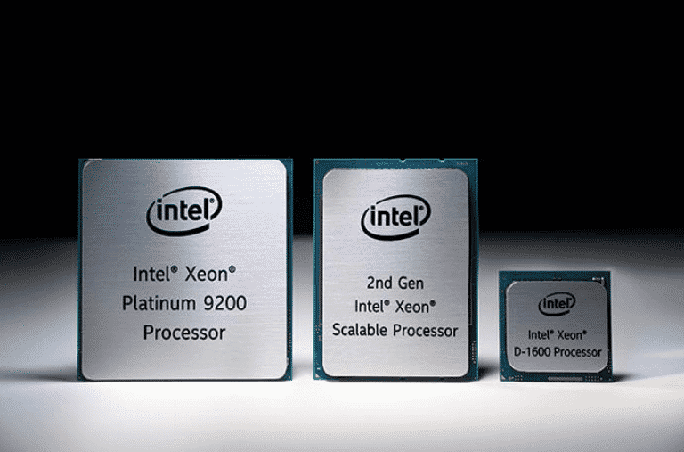
Why this paper is unique?
The intel xeon processors are definitely power processors. They have a large number of cores, and they also have special features that make them great for running intensive programs and mission-critical tasks. Arguably the most important of these features is error-correcting code memory.

Slide 13
Terminology used in this paper
Xeon processors support error checking and correcting memory so they are more stable and less prone to data corruption due to memory errors.
Xeon is a 400 mhz microprocessor from intel for use in "mid-range" enterprise servers and workstations. On a server motherboard from intel xeon processors will be able to do multiprocessing sharing the same 100 mhz bus. Xeon is replacing the pentium pro as intel's main enterprise microchip. Xeon is designed for internet and large transactional database servers as well as for engineering, graphics, and multimedia applications that require moving a lot of data around quickly. Xeon is the high end of the pentium line ( celeron is the low end).

Slide 14
The Importance of Maximizing Performance on Intel Xeon processors first
The single most important lesson from working with intel xeon processors is to prepare for intel xeon processors to fully exploit the performance that an application can get on intel xeon processors first.
Trying to use a processor, without having maximized the use of parallelism on intel xeon processor, will almost certainly be a disappointment. Higher performance comes from pairing parallel software with parallel hardware because it takes parallel applications to access the potential of parallel hardware. The best place to start is to make sure your application is maximizing the capabilities of an intel Xeon processor.

Slide 15
So What Exactly is the Intel Xeon Processor?
The intel xeon platinum processor, or simply the intel xeon, is a specialized processor that was made to ensure optimal performance from servers. An ideal server balances two qualities, the throughput or TPT – which is the capacity it can provide – and the per core performance or PCP – which tells you how quickly it performs necessary tasks. The latter of these is more important though; no amount of increased TPT can compensate for inadequate PCP.
The intel xeon processor is one of intel’s latest launches, and it is both fast and reliable in that it ensures an excellent tpt and pcp ratio for servers and thus ensures optimum performance. Before we get into the specifics of the intel xeon, please note that the benchmark we will be using is the intel core i7 processor, one of their most popular processors and a cult favorite. By looking at this topic in terms of the intel xeon vs the i7, we can gain some better perspective.

Slide 16
Conclusion
Though intel has been the giant in the microprocessor industry, amd(advanced micro device) ,however, has been in the frontline of most innovative technologies. AMD manufacturer has succeeded in setting intel on their toe. We are also of the opinion that if AMD was not in the processor world, probably intel would have monopolized the industry. The slogan would have been “intel and others”.
Further research can be carried out on a streamlined and thorough comparison on one subsystem in the intel and amd microarchitecture such as memory access technology or power management subsystem in a distributed environment.

Slide 17
Future work
Intel has revealed its most powerful generation of data center processors yet as it looks to step up to the challenge of a smarter and more connected world. Advertisement the new xeon scalable processors provide the company’s greatest leap forward in performance in a decade, intel says, “greatly aiding the development of compute-heavy technologies such as AI and 5G networks.This is our largest gen on gen performance improvement in the past decade”
..This is a revolutionary change.

Slide 18
Acknowledgments
I would like to thank my honourable khan Md. Hasib sir for his time, generosity and critical insights into this research.

Slide 19


